Slide 1


Daily News Classifier
INFO 6105 - Data Science Engineering Methods and Tools (34274)
By Team 23 -
Aditya Kulkarni (NUID: 001001395)
Mohammed Saqlain Kazi (NUID: 001023485)

Slide 2
Introduction
The surge in the number of news has necessitated the need to categorize news so that it can be easily found.
Due to the presence of huge amount of data in electronic format, using software that can access and interpret it, as well as derive facts that can help decision-making, has become critical.
This will allow users to get real-time news on their interests without wasting time.
We implemented six machine learning models that predict the categories of news articles based on title using the supervised classification method.
Our framework saves users time by presenting them with news stories that are organized into categories.

Slide 3
Approach
Classification is a difficult activity as it requires pre-processing steps to convert the textual data into structured form from the un-structured form.
Text classification process involves following main steps for classification of news article:
Data collection
Pre-processing
Feature selection
Classification techniques application
Evaluating performance measures

Slide 4
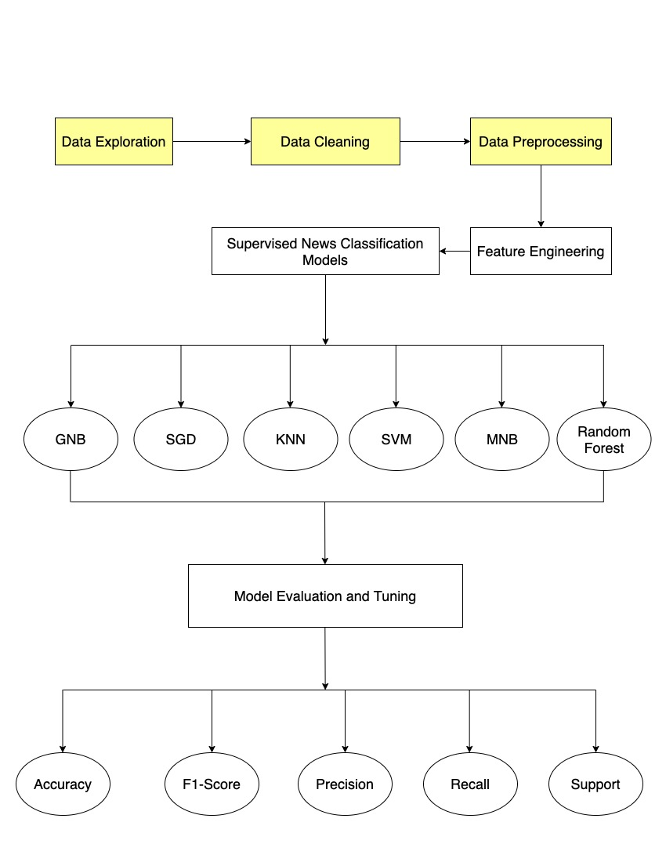
Flow Diagram
The flow diagram involves the following steps in classifying the news data:
Data Cleaning
Data pre-processing
Feature Extraction
News Classification (Supervised Machine Learning Models)
Model Evaluation and Tuning
Analyze results

Slide 5
Data Cleaning
Special character and non ascii character cleaning: special characters such as “\n” double quotes must be removed from the text along with non ascii characters
Up-case/down-case: “Book” and “book” to be the same word and have the same predicting power. For that reason we have down cased every word
Punctuation signs: characters such as “?”, “!”, “;” have been removed
Stop words: words such as “what” or “the” won’t have any predicting power since they will presumably be common to all the documents. They may represent noise that can be eliminated

Slide 6
Data Pre-processing
Pre-processing refers to the transformations applied to our data before feeding it to the algorithm
Some specified Machine Learning model needs information in a specified format
For achieving better results from the applied model in Machine Learning the format of the data must be in a proper manner
We have performed data pre-processing on the raw dataset to convert it into a clean and useable dataset

Slide 7
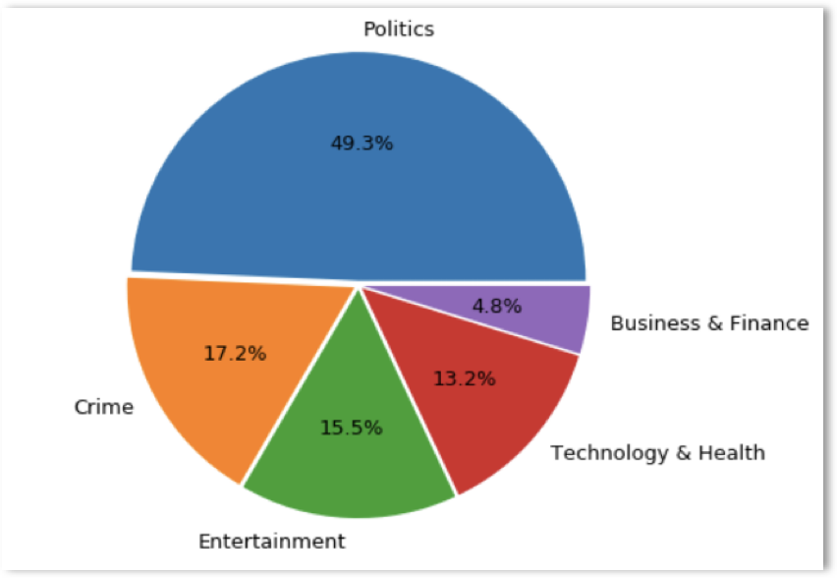
Feature Engineering
Feature engineering is the process of transforming data into features to act as inputs for machine learning models
For feature engineering we created clusters for categories
Initially there were around 170 categories which we grouped into 5 categories as below:
Entertainment
Health and Technology
Politics
Crime
Business and Finance

Slide 8
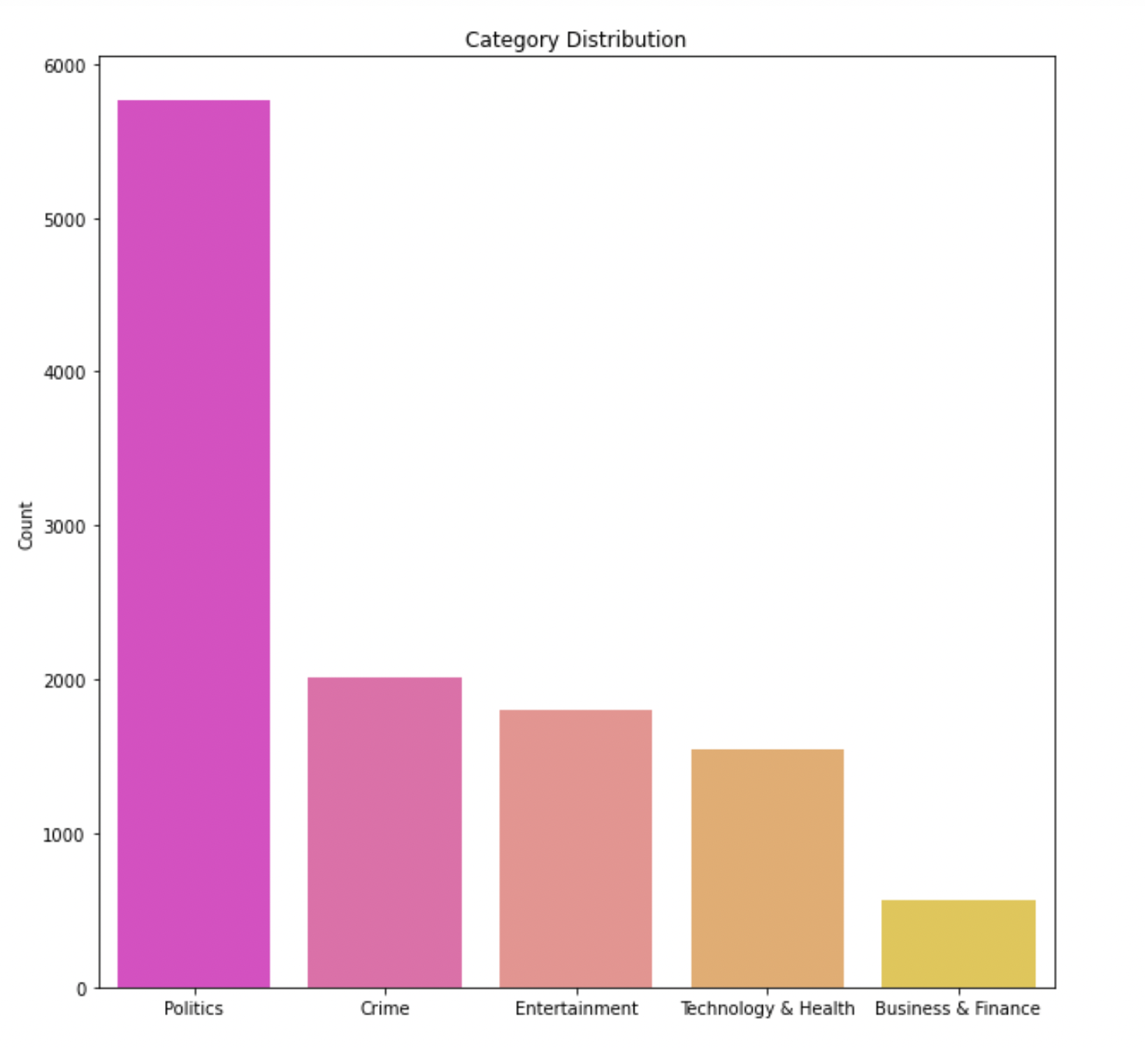
Category Distribution of Data

Slide 9
Libraries used
Numpy: convert confusion matrix to array and plot confusion matrix for each model
Pandas: import a tsv file as a dataframe; concatenate multiple data frames into a single DataFrame
SciKit-Learn: model training and calculates the model metrics like accuracy, score, etc
MatPlotLib: Displays a Bar Chart to visualize the news category distribution
Seaborn: Display bar charts to map categories against the count of news articles derived from the dataset

Slide 10
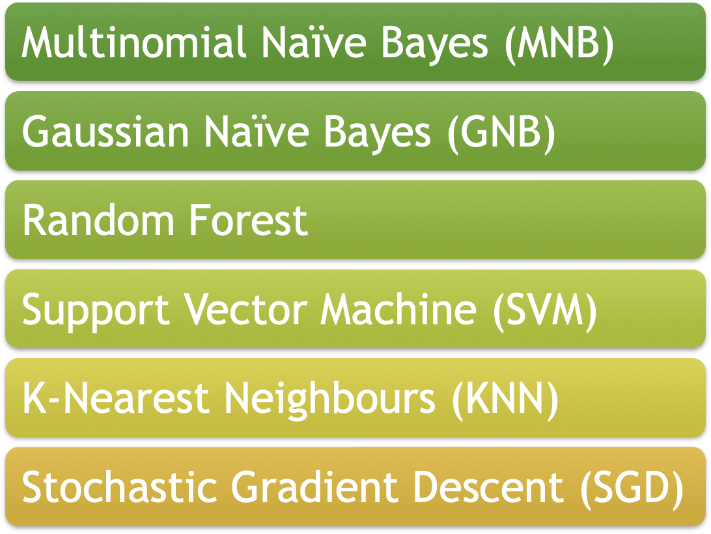
ML Algorithms

Slide 11
Multinomial Naïve Bayes (MNB)
Probabilistic classifier based on applying Bayes Theorem
Effective for discrete feature classification (e.g., word count for text classification)
Computes the posterior probability of the news belonging to different classes and assigns the news to the category with the highest posterior probability

Slide 12
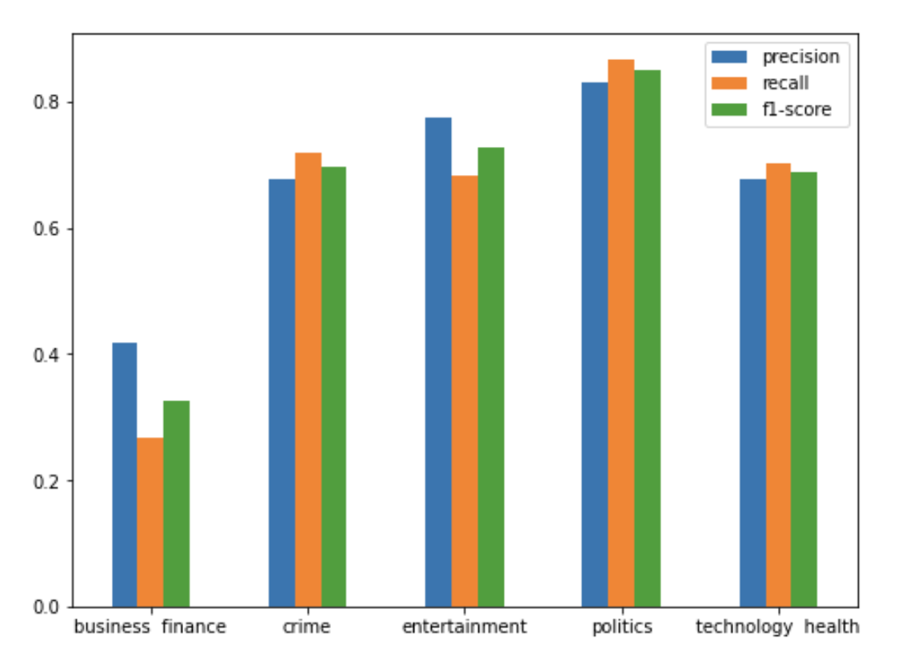
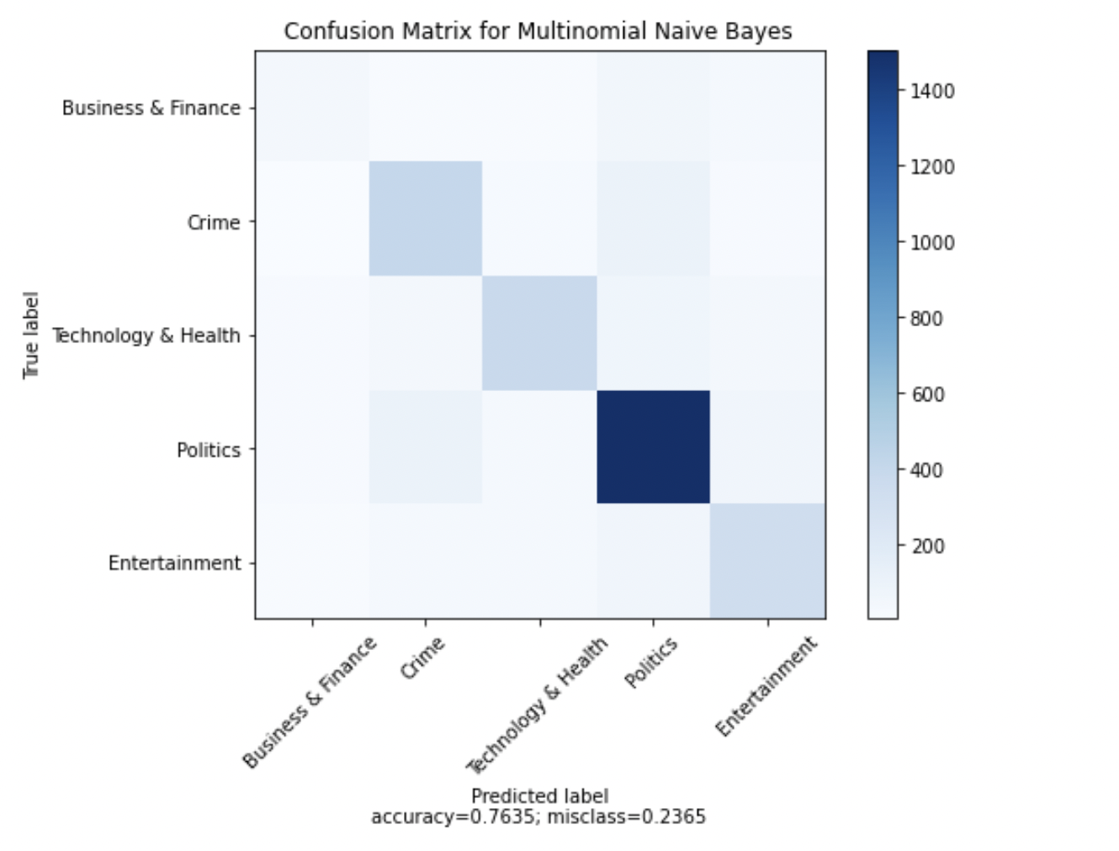
Results for MNB

Slide 13
Gaussian Naïve Bayes (GNB)
Gaussian Naive bayes is useful when working with continuous values.
Good at serving as a document classification model due to its simplicity.
It performs well in case of categorical input variables.
It also performs well in multi-class prediction.

Slide 14
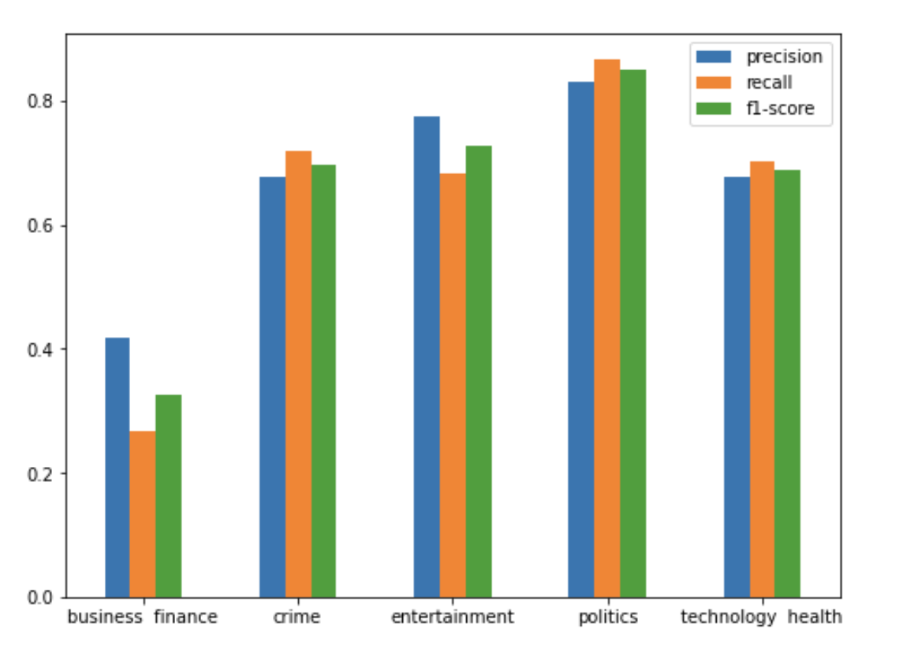
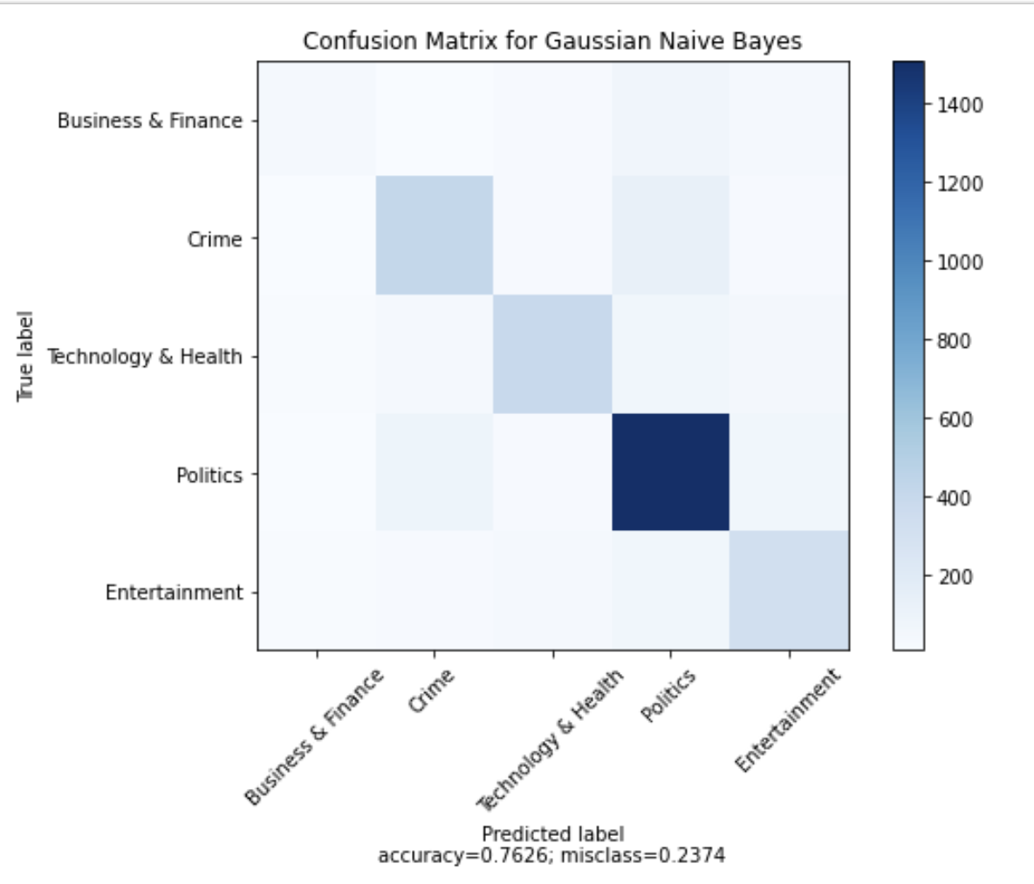
Results for GNB

Slide 15
Random Forest
Fits the number of decision tree classifiers on various sub samples on the data set
Uses averaging to improve the predictor accuracy and control over fitting
We believed that random forest would do better as an ensemble approach than decision trees.

Slide 16
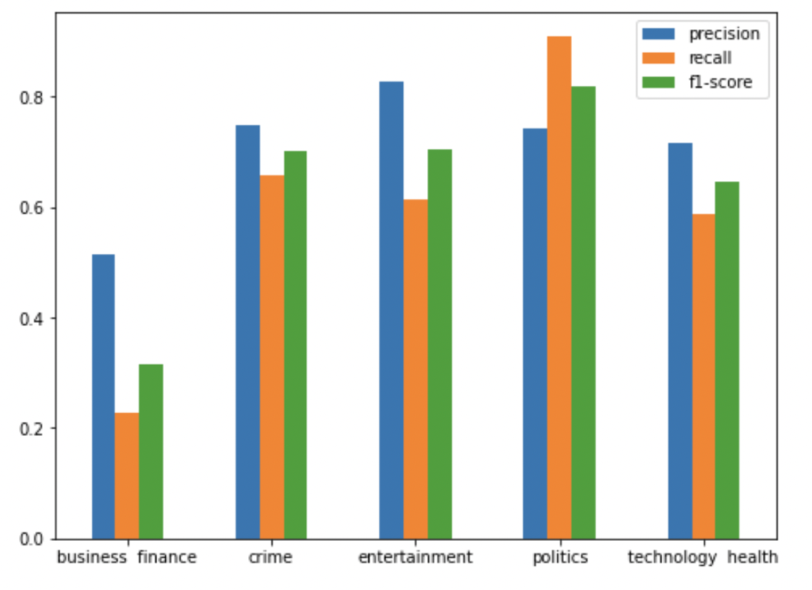
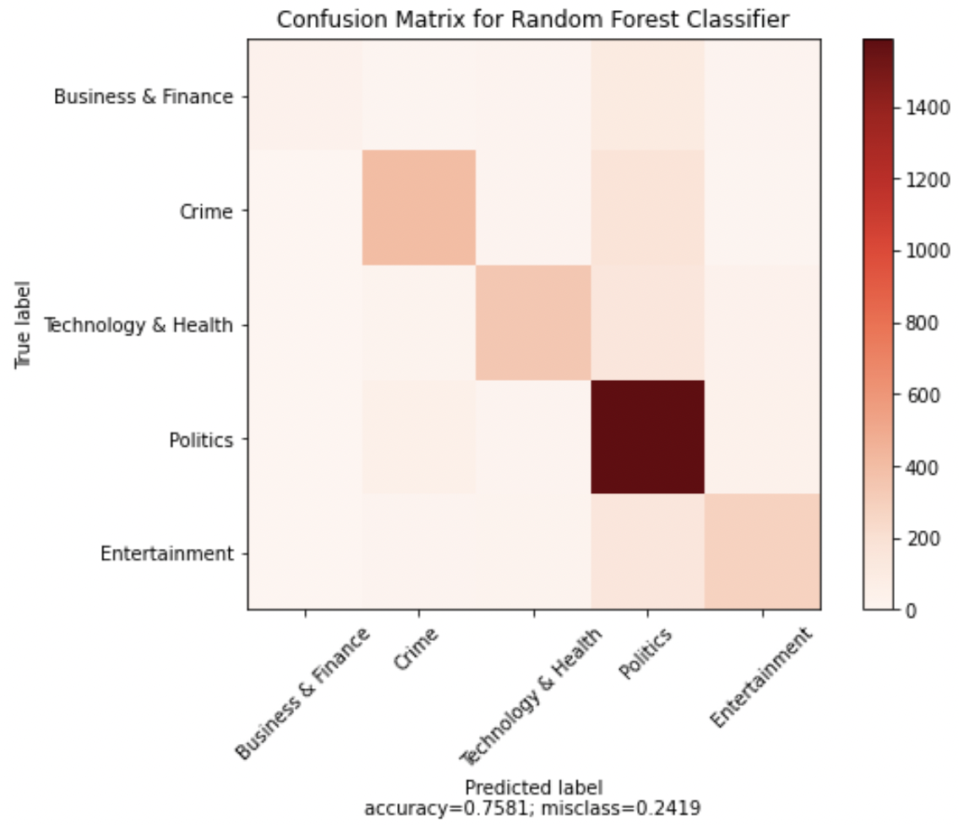
Results for Random Forest

Slide 17
K-Nearest Neighbours (KNN)
k-nearest neighbors algorithm (k-NN) is a non-parametric method used for classification
The input consists of the k closest training examples in the feature space
An object is classified by a plurality vote of its neighbours, with the object being assigned to the class most common among its k nearest neighbors (k is a positive integer, typically small)
If k = 1, then the object is simply assigned to the class of that single nearest neighbor

Slide 18
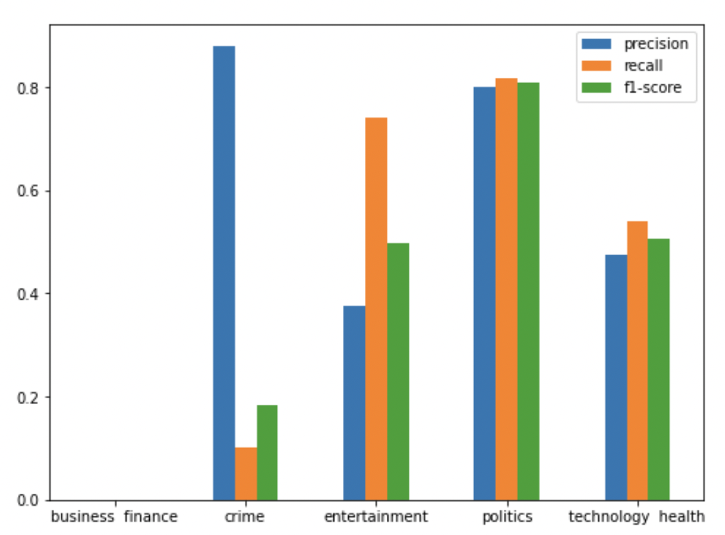
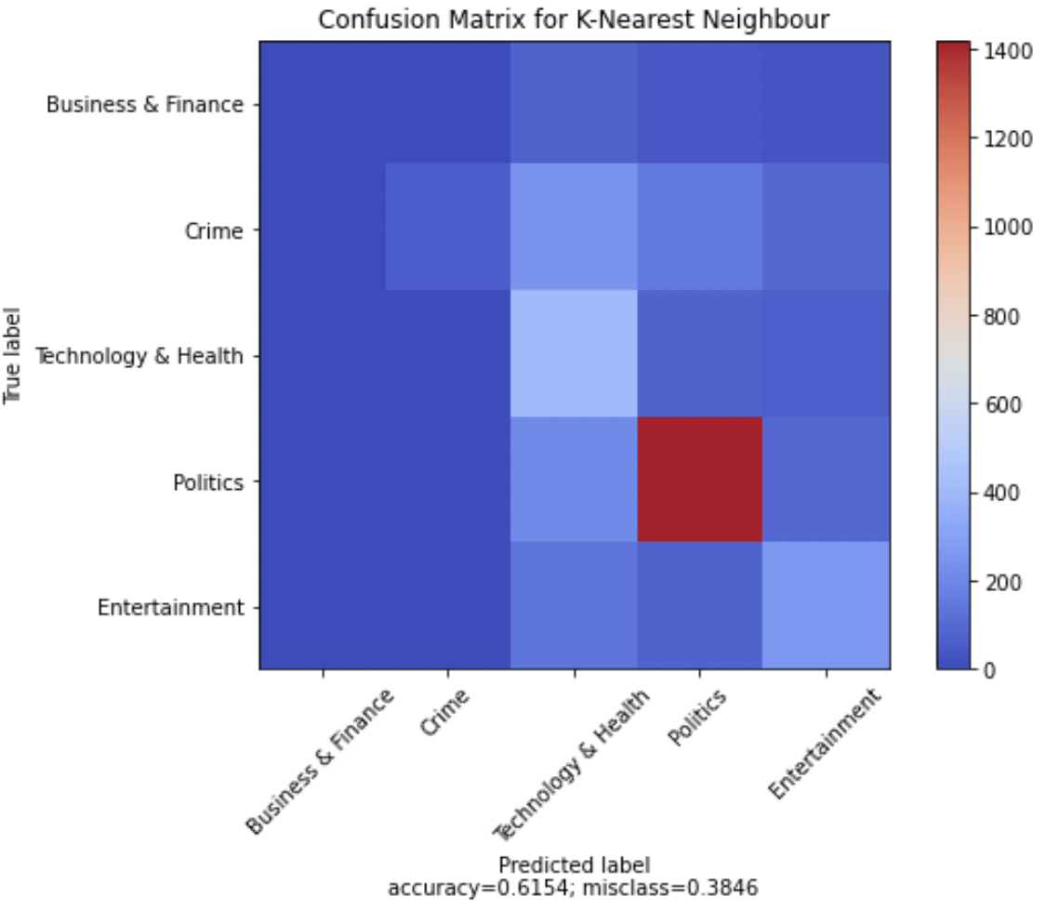
Results for KNN

Slide 19
Support Vector Machine (SVM)
Supervised learning method used for classification regression and outlier detection
It is flexible and, unlike neural networks, does not consume a lot of time.
Here, we implement Scikit-Learn SVC module to run the SVM algorithm
We have implemented the SVM models using linearSVC, RBF, Polynomial SVC.

Slide 20
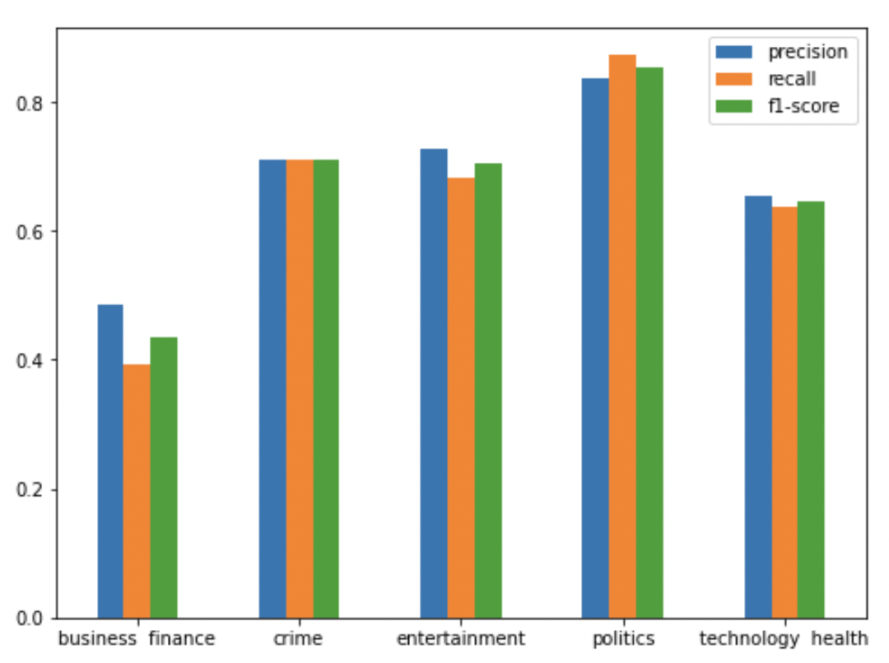
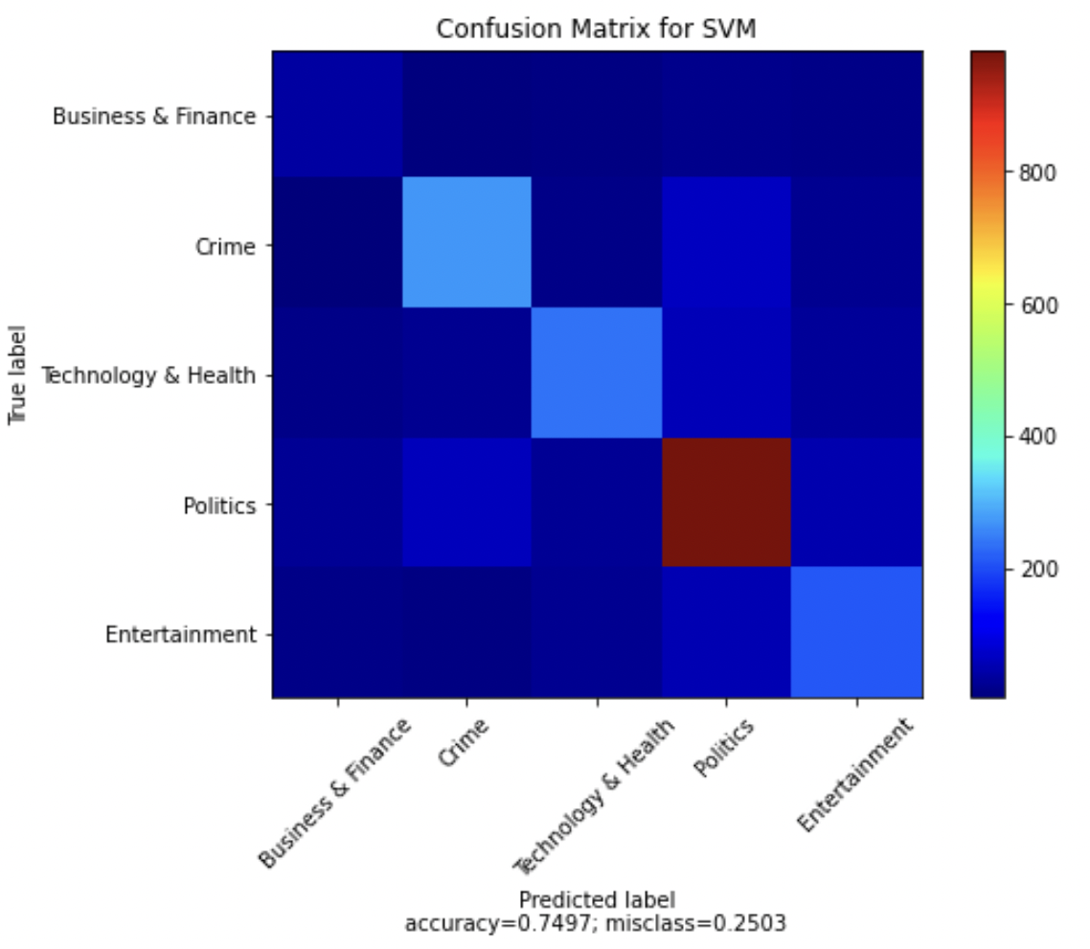
Results for SVM
Using linearSVC

Slide 21
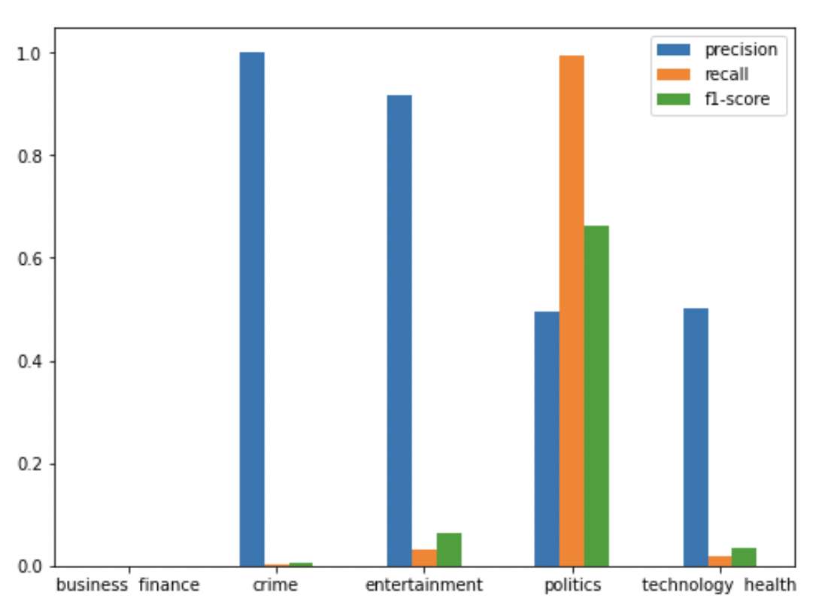
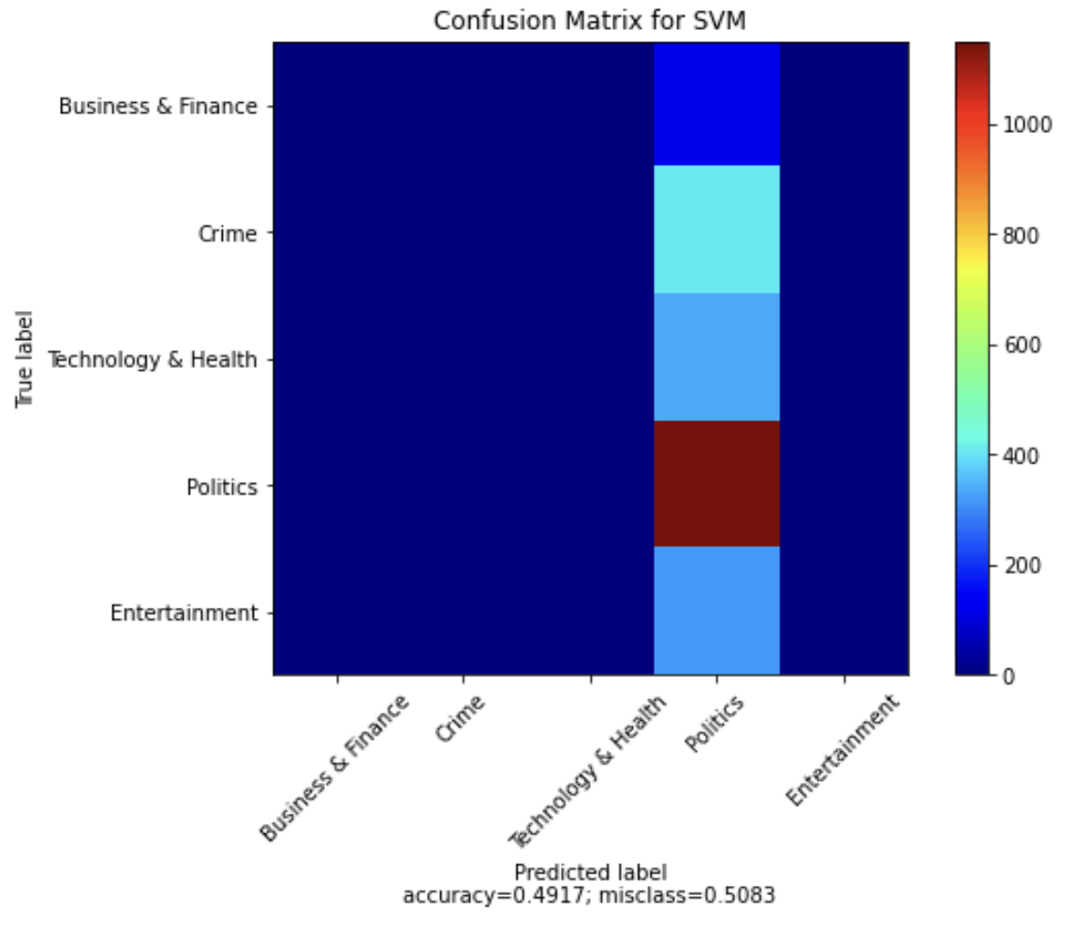
Using RBF kernel

Slide 22
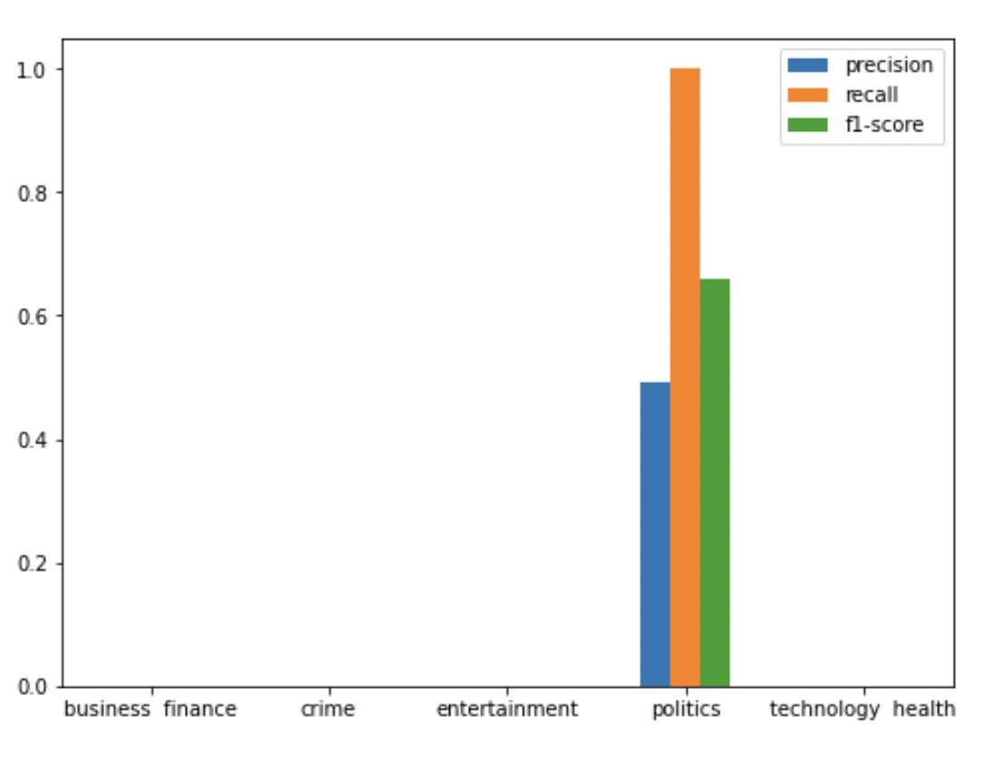
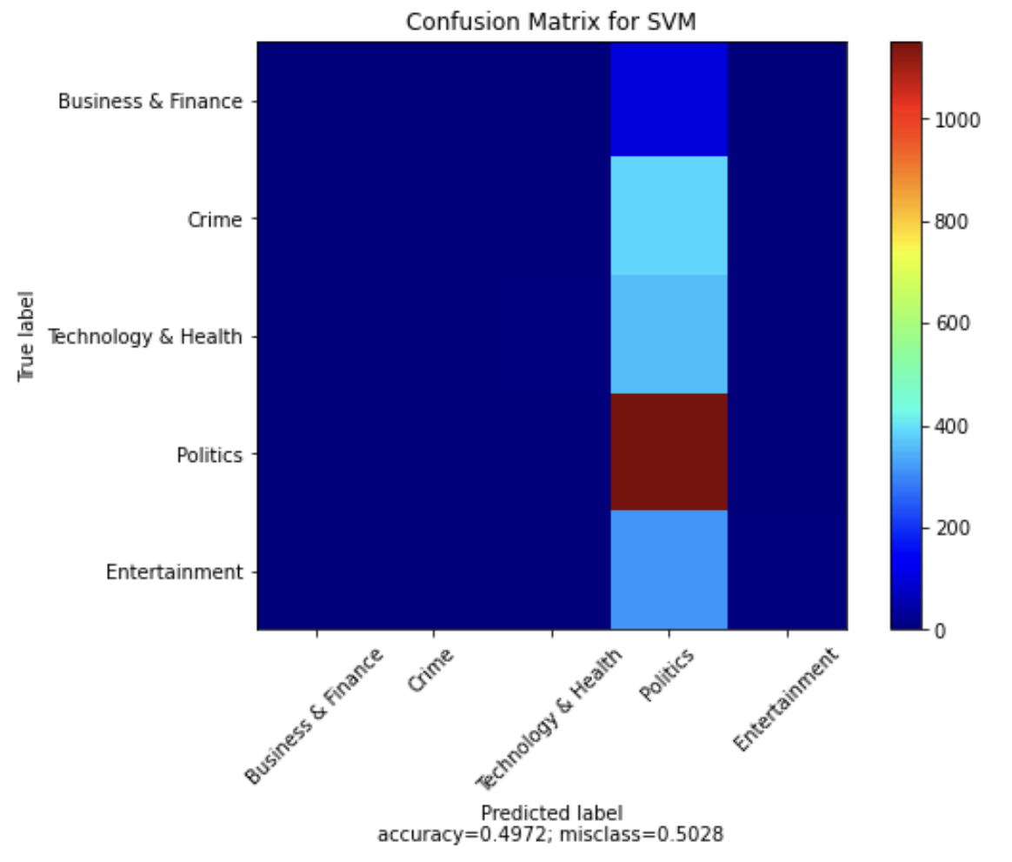
Using Polynomial (degree = 3) SVC kernel

Slide 23
Stochastic Gradient Descent (SGD) Classifier
Stochastic Gradient Descent Classifier provides high efficiency which is basically linear in the number of training samples.
It is easier to fit in the memory due to a single training example being processed by the network..
For larger datasets, it can converge faster as it causes updates to the parameters more frequently

Slide 24
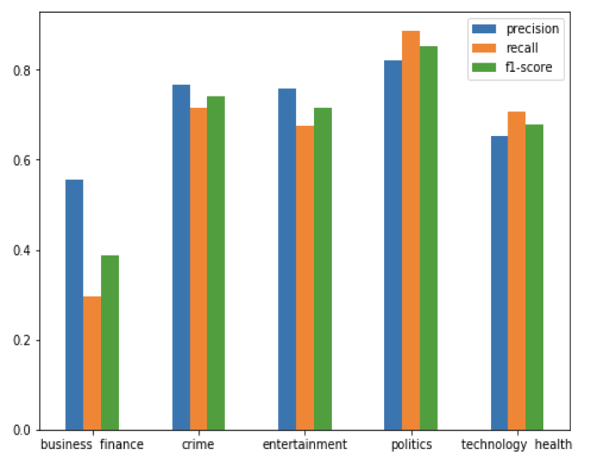
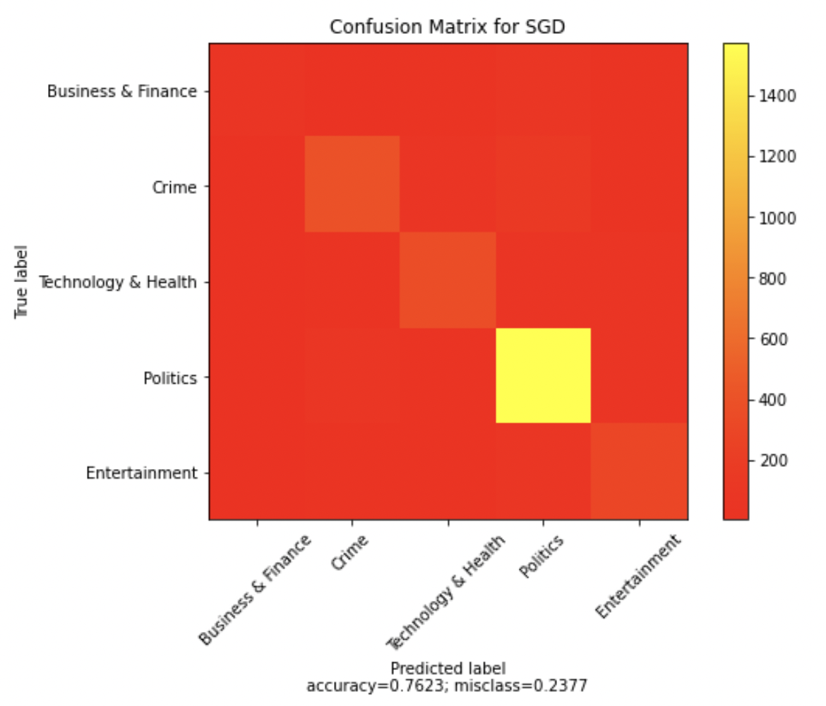
Results for SGD

Slide 25
Thank You
Credits : Prof. Handan Liu and TA Team

Slide 26
Q & A

